Slide 1





Slide 2
Code Reuse in a Trusted Research Environment
Reusable Actions in OpenSAFELY
Iain Dillingham, NHS-R, November 2022

Slide 3
TOC
What is OpenSAFELY?
Why reuse code?
Code reuse in practice
TREs and code reuse: some challenges
What are scripted actions?
What are reusable actions?
From scripted to reusable
Why?
Security
Where?

Slide 4
“OpenSAFELY is a secure, transparent, open-source software platform for analysis of electronic health records data.”

Slide 5
Why reuse code?
Avoid duplicating identical lines of code in different locations
Instead, use the same lines of code in each location
Over time, improve the functionality that those lines of code implement
Tests
Documentation
Bugs
Features
Do this within, as well as between, projects

Slide 6
Code reuse in practice
Code reuse within a project:
Factor code into functions, classes, methods
Factor these into modules or packages
Code reuse between projects:
Release these to software repositories, such as PyPI or CRAN

Slide 7
TREs and code reuse: some challenges

Slide 8
Skills challenges
Releasing code requires a different set of skills to writing code
We need to make choices:
Tooling (Flit, Poetry, Setuptools)
Versions of our chosen programming language (3.8, 3.9, 3.10)
Operating systems (Unix-like, Windows)
Versioning scheme (SemVer, CalVer)

Slide 9
Security challenges
You may be familiar with this
pip install matplotlib
or this
conda install matplotlib
or this
install.packages("ggplot2")
In each case we're downloading a package from the Internet to a computer
What if the computer is within a TRE?

Slide 10
Security challenges
If packages can be downloaded, then can data be uploaded?
TREs probably shouldn't have unrestricted access to the Internet
Where are packages hosted? Which software repository? Which mirror?
Software repositories and mirrors can be compromised
TREs probably shouldn't have unrestricted access to software repositories and mirrors
Did we get the package we asked for?
Packages can be compromised
TREs probably shouldn't have unrestricted access to packages

Slide 11
TREs and code reuse: some challenges
The skills and security challenges can be addressed
But they distract us from achieving our aims:
Avoid duplication
Use the same lines of code in each location
Improve functionality
Use within, as well as between, projects

Slide 12
[Scripted | Reusable] actions in OpenSAFELY

Slide 13
What are scripted actions?
An OpenSAFELY project is a set of steps, which when run, produce a result
We call each step an action
Each action is run within a Docker container, which doesn't have access to the Internet
Some actions address specific tasks: a cohort-extractor action, for example, allows a researcher to extract a cohort
The researcher analyses the cohort by writing one or more scripted actions
Scripted actions are project-specific

Slide 14
What are reusable actions?
Reusable actions are scripted actions that have been decoupled from their projects
They help us achieve code reuse within, as well as between, projects
Whilst we could think of reusable actions as packages, it's better to think of them as reusable projects

Slide 15
From scripted to reusable

Slide 16
First step: refactoring
Typically, project-specific information is hard-coded in a scripted action
For example, we may hard-code the location of an input file like this
path_to_input_file = "data/input.csv"
def my_function():
my_other_function(path_to_input_file)
which we may run like this
python my_scripted_action.py

Slide 17
First step: refactoring
In a reusable action, project-specific information is passed as arguments to a command-line interface
For example, we may rewrite our scripted action as a reusable action like this
def my_function():
parser = ArgumentParser()
parser.add_argument("--path-to-input-file")
args = parser.parse_args()
my_other_function(args.path_to_input_file)
which we may run like this
python my_scripted_action.py --path-to-input-file data/input.csv

Slide 18
First step: refactoring
Making a command-line interface is a writing code skill, not a releasing code skill
Remember: we use the same workflow whether we are working on a scripted action or a reusable action

Slide 19
Next steps
Create a new project in <https://github.com/opensafely-actions>
Copy the scripted action to the new project: the scripted action is now a reusable action
Add README.md
Add action.yaml, which contains the run command
Point the existing project to the reusable action like this
my_reusable_action:v0.0.1 --path-to-input-file data/input.csv
Remember: we use the same workflow whether we are working on a scripted action or a reusable action

Slide 20
Why create reusable actions?
By decoupling scripted actions from their projects we:
Create a location for making improvements (a new project)
Access a mechanism for sharing improvements: the Actions Registry
Access a mechanism for receiving credit for our work (potentially!)

Slide 21
Security redux
OpenSAFELY restricts access to the Internet; only
<https://github.com/opensafely>
<https://github.com/opensafely-actions>
are accessible, by proxy.
We have more control over these GitHub organisations than we do over software repositories and mirrors
Reusable actions have a similar security profile to scripted actions

Slide 22
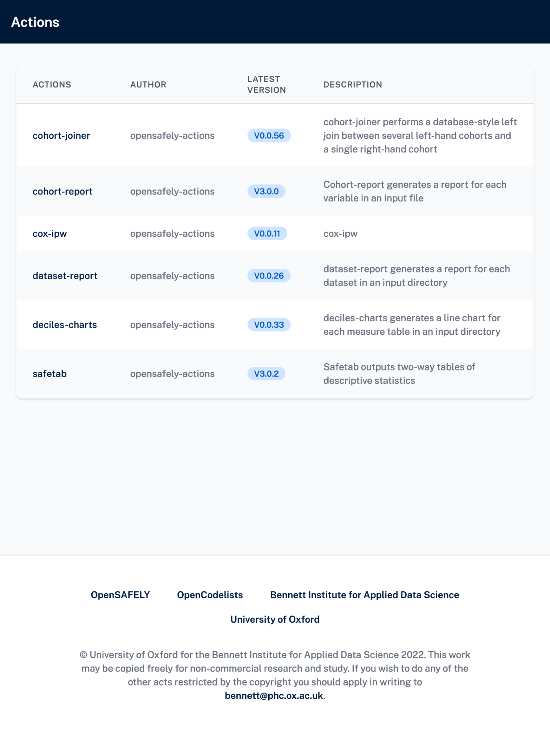
Where can I find reusable actions?
Actions Registry: <https://actions.opensafely.org/>
Code: <https://github.com/opensafely-actions>
Documentation: <https://docs.opensafely.org/actions-reusable/>

Slide 23



Get in touch!
www.bennett.ox.ac.uk
bennett@phc.ox.ac.uk
@BennettOxford

